Slide 1
Sistem library
Journal Review
Kelompok 2 | TI-22-PB
Muhammad Fadlan (222310026)
Dimas Permana (222310045)
Fajar Nurulloh (222310050)

Slide 2
Table of Contents
01
02
03
Section
Section
Section
04
Section
Program
Use Case
Activity Diagram
Class Diagram

Slide 3
01
Program

Slide 4
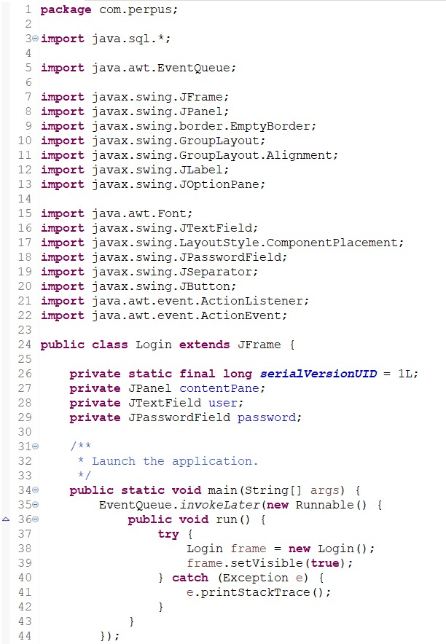
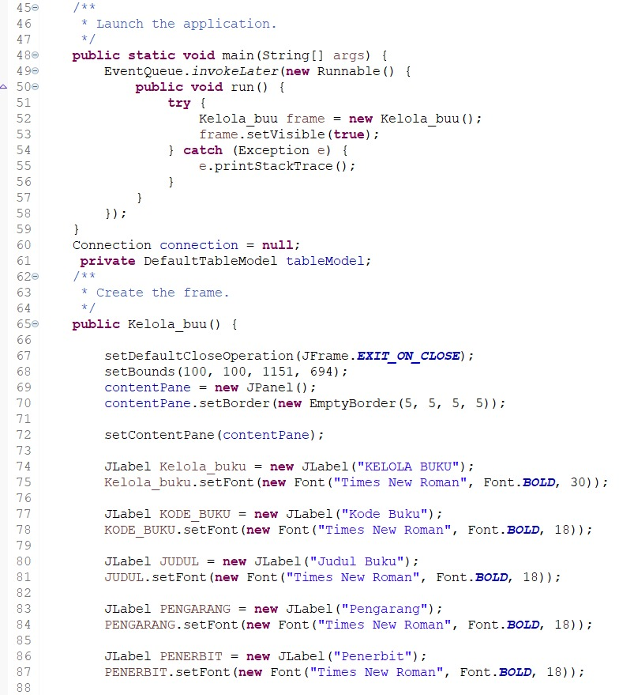

Slide 5
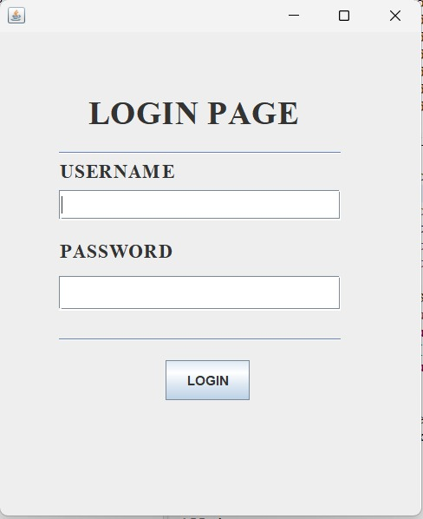
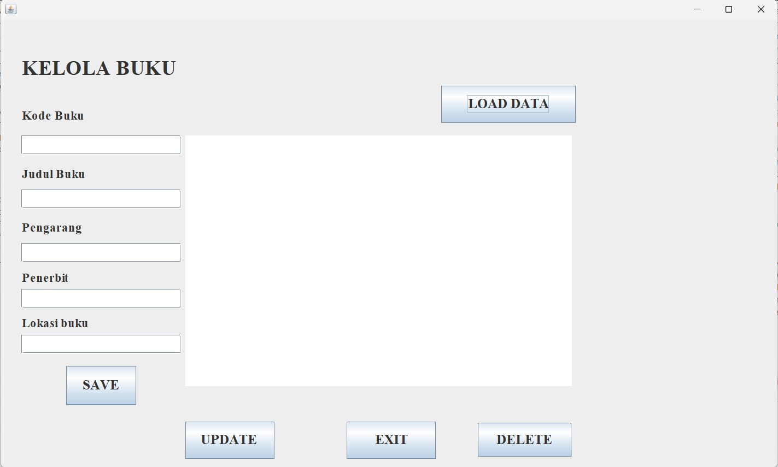

Slide 6
02
Use Case

Slide 7
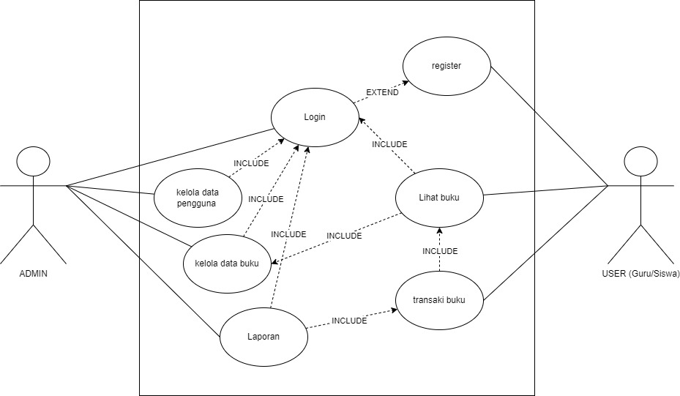
Use Case

Slide 8
03
Activity Diagram

Slide 9
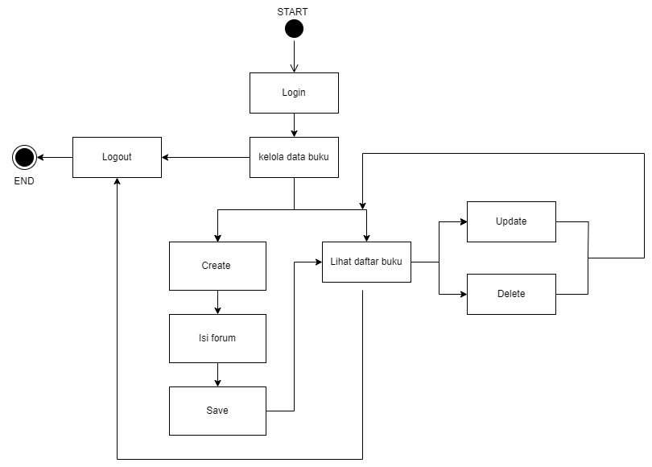
Activity Diagram

Slide 10
04
Class Diagram

Slide 11
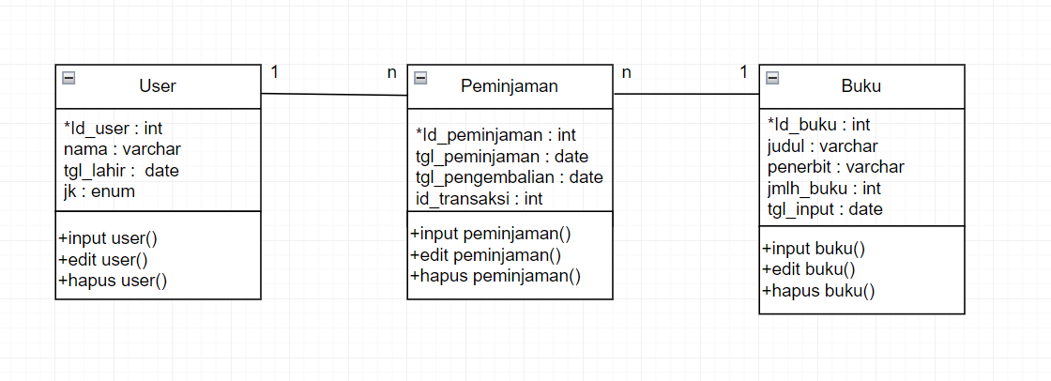
Class Diagram

Slide 12
Terimakasih!
Apakah ada yang ingin bertanya?

